Slide 4
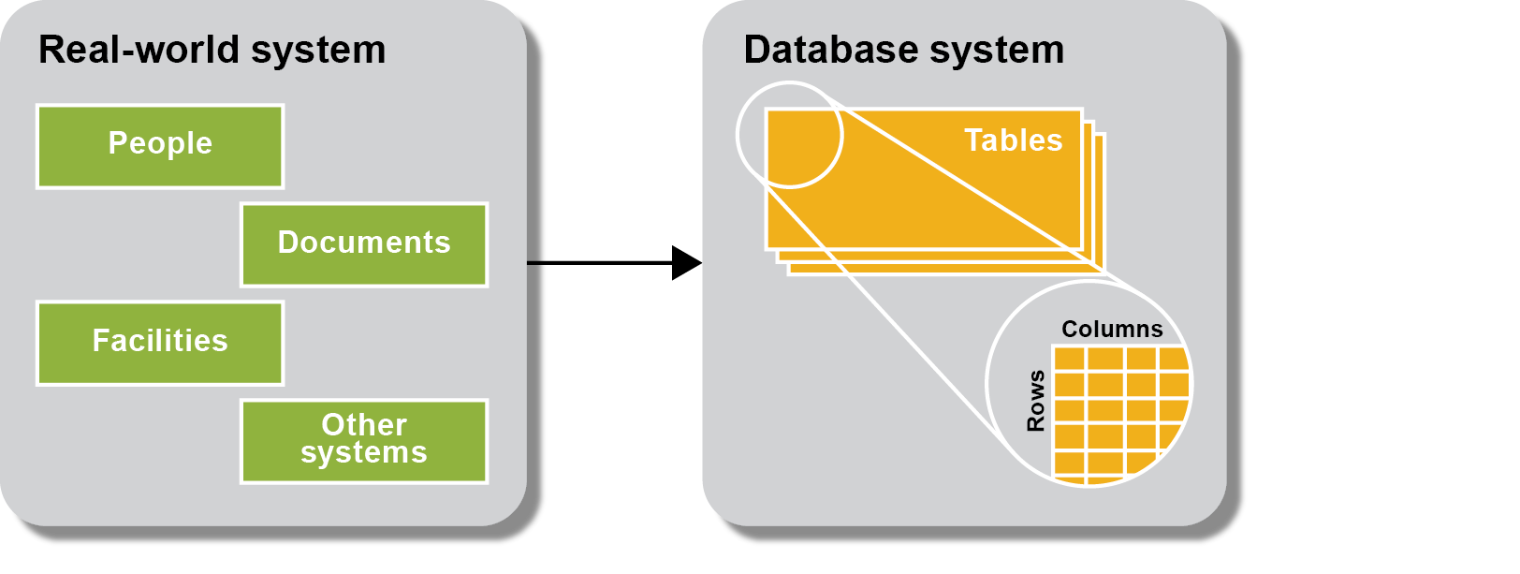

Slide 5
Notes:
Google splits their database into multiple databases in different locations, tables, etc.
Type of data storing
Do I store things in one big table with many columns? Or split them up into multiple tables and how many?
Do that
Need to link tables together (helpful for select, etc.) to save time in calculations
Primary key: column in table that can be used to uniquely identify who you are, kind of duplicated into a related table
Foreign key: primary key that came in as foreign information
If we update a new customer, make a new id for the new customer, then that id is going to flow to the address table and the address is filled in
Not worth the while unless in big organization
How many layers do I create?
s

Slide 7
Notes:
Options:
Have these 18 columns in one table

Slide 8
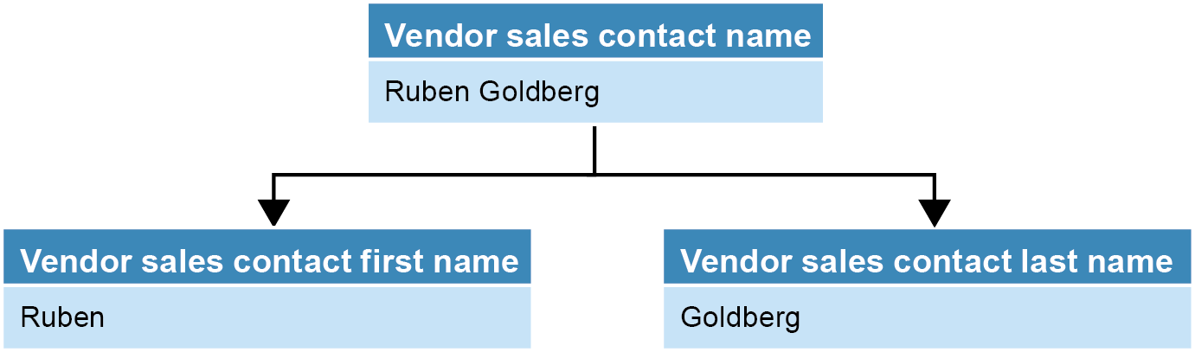

Slide 9
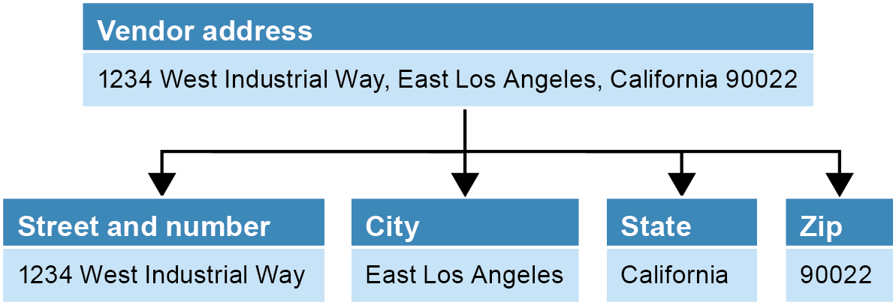

Slide 10
Notes:
Splitting into 2 different tables

Slide 13
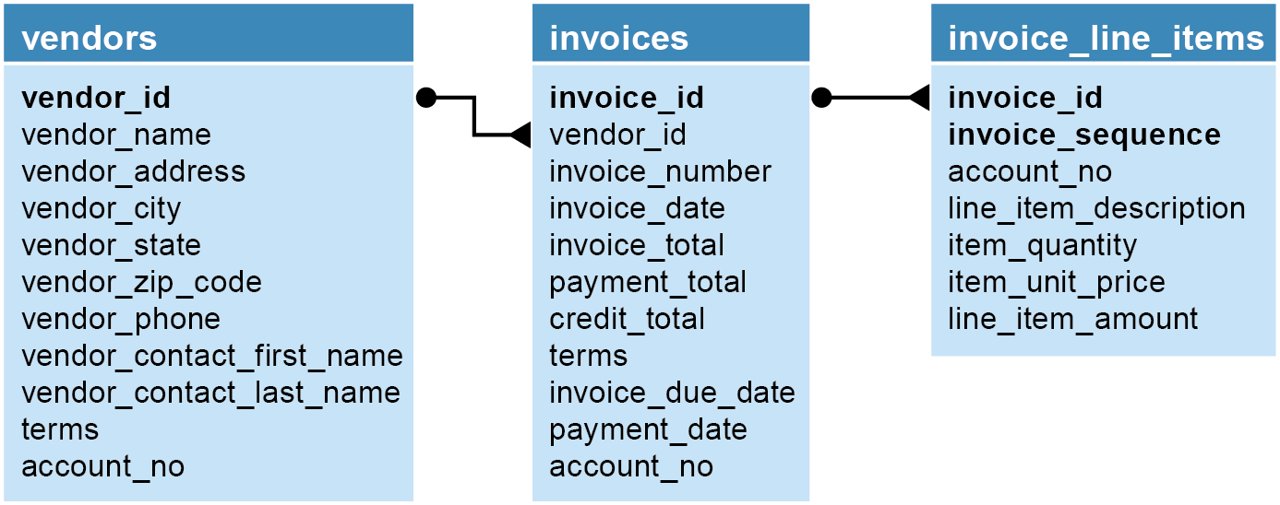
Notes:
Invoice_id in invoices = primary key
Invoice_id in invoice_line_items = foreign key

Slide 14
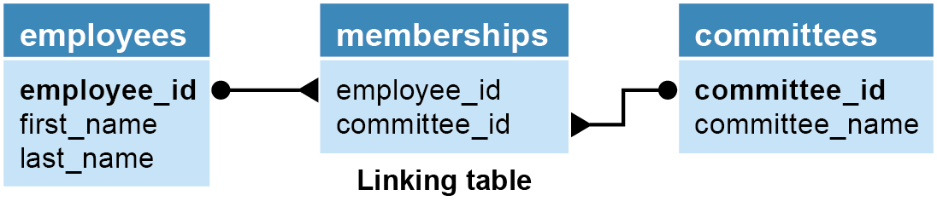
Notes:
Employees and committees are on the same level
Notice employees don’t directly link to committees
Middle man, don’t want overlap, bridging table

Slide 15
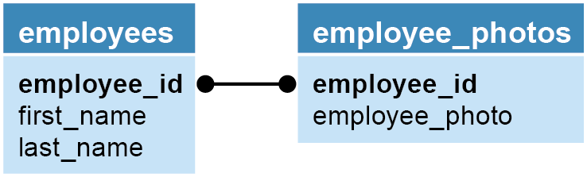
Notes:
Pulling into seprarte table because employee_photo is a blob (large storage, good idea to separate things)
Participation relationship
Cardinality vs participation

Slide 16
Notes:
May be affected
Must insert first in primary key table and it’ll flow down in foreign key
It doesn’t flow backwards
Doesn’t flow backwards

Slide 18

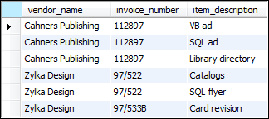

Slide 19
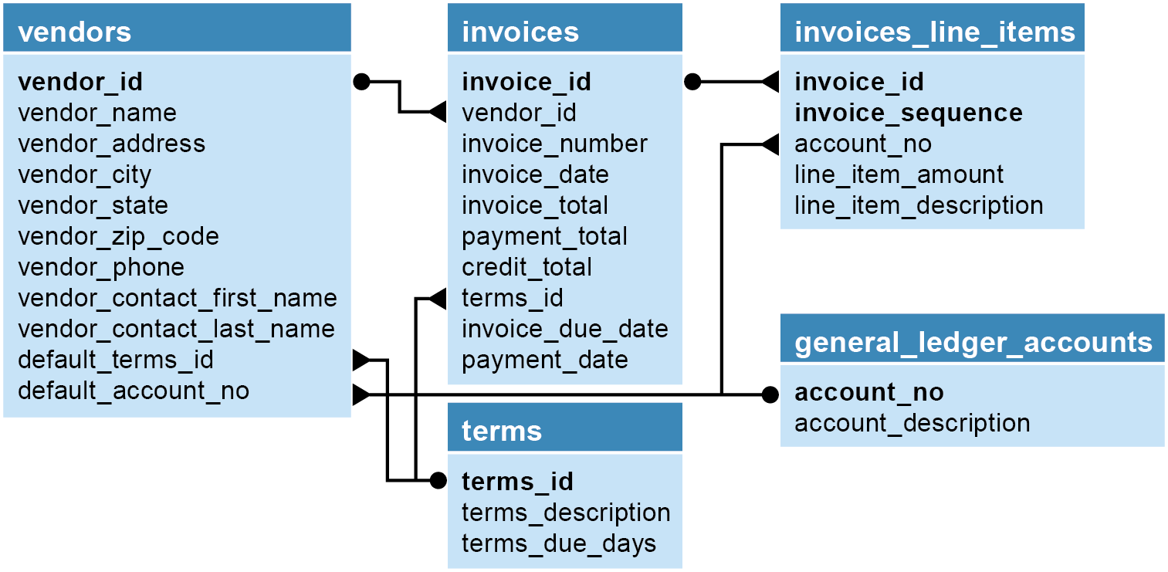

Slide 21
Notes:
Starting to split the database up
Not an exact number, depends on userability and hardware

Slide 22
Notes:
2. One table and one primary key, and if you need another, split into another table
3. Same as two
Better is performance

Slide 23
Notes:
Too much effort, only for large databases

Slide 25



Slide 26
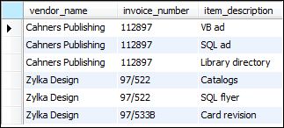

Slide 27
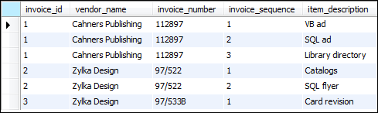

Slide 29
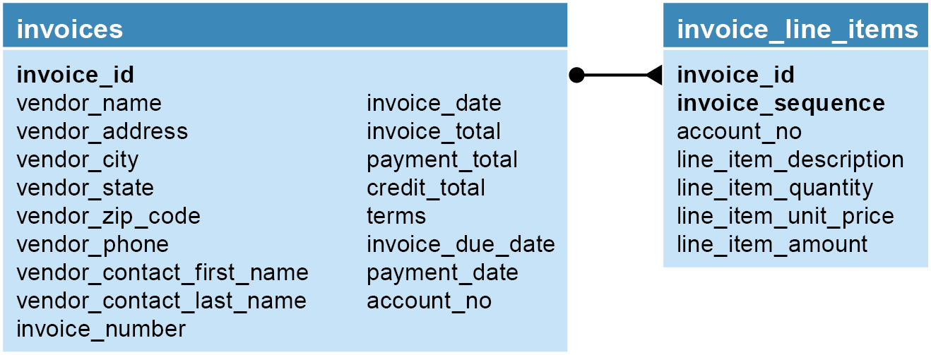

Slide 31


Slide 32
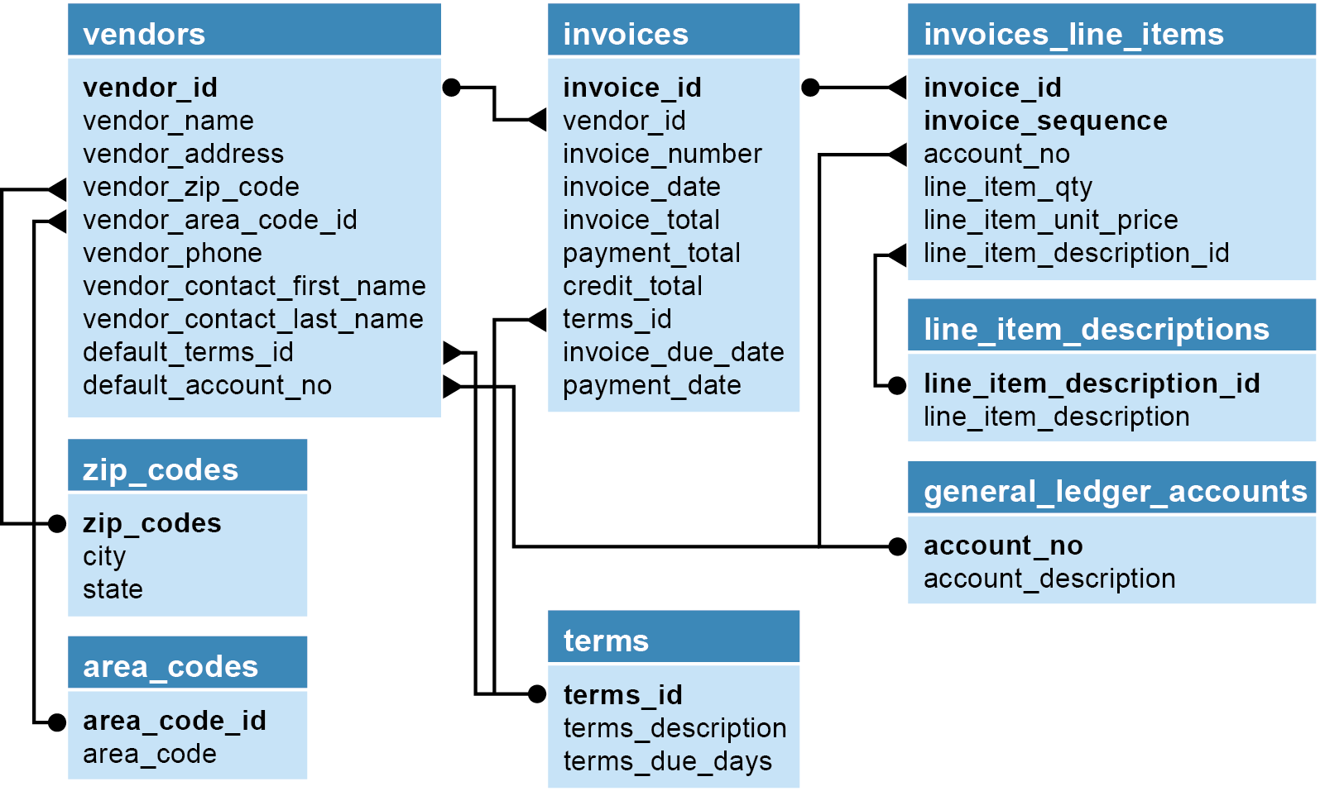

Slide 34
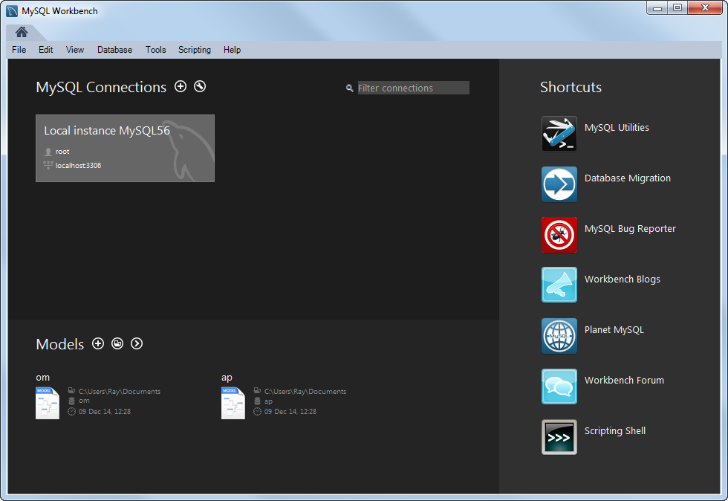

Slide 36
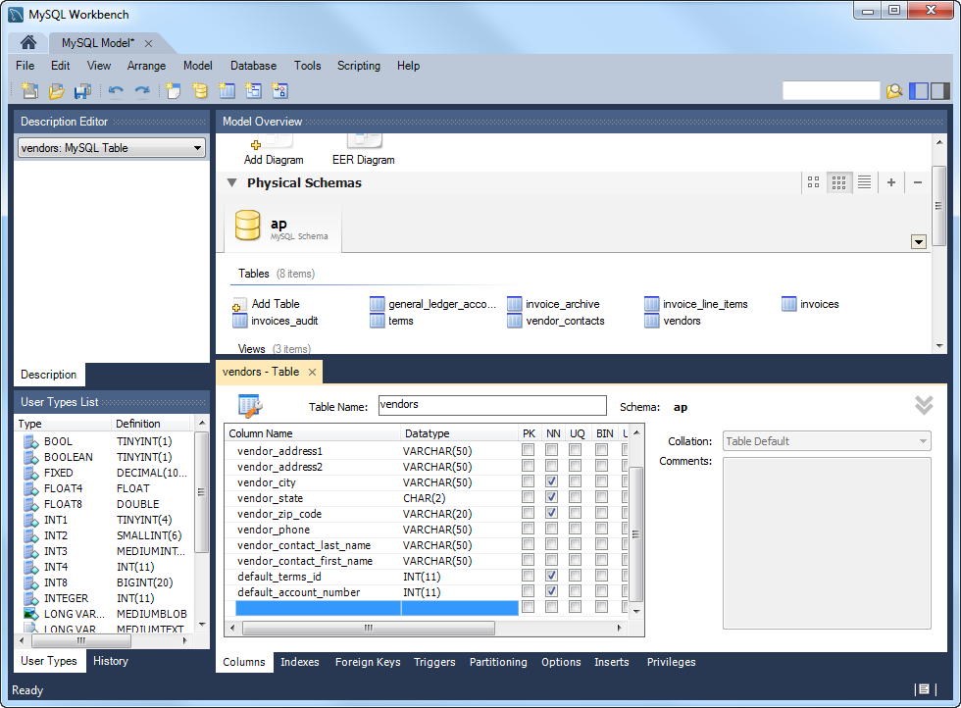

Slide 38
